Slide 1
Day 2, Session 2: Raster Data
BC Gov Intermediate Remote Sensing Workshop 2023
Darren Wiens
Sparkgeo

Slide 2
Session Agenda
Talk about Raster Data
Google Colab

Slide 3
Data Structures Recap
Tables/Vector data
pandas (data frame)
GeoPandas (spatial data frame)

Slide 4
Data Structures Recap
Raster data
numpy (grid)
rasterio (numpy grid + spatial profile)

Slide 5
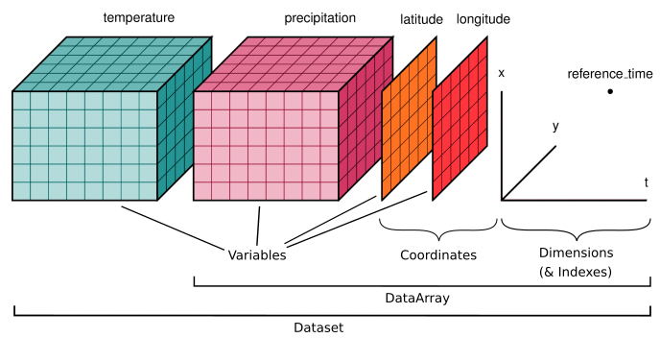
Xarray
https://docs.xarray.dev
Builds on numpy arrays by adding labels for dimensions, coordinates, and attributes
Data structures:
Dataset
DataArray
We’ll mostly talk about DataArray
source: https://docs.xarray.dev/en/stable/user-guide/data-structures.html

Slide 6
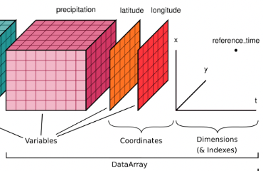
Xarray DataArray
values (variables)
gridded numpy array(s)
often:
band data (e.g. red, green, blue)
time
other
source: https://docs.xarray.dev/en/stable/user-guide/data-structures.html

Slide 7
Xarray DataArray
dims
an array of coordinate names
for example:
[“lat”, “long”, “t”]
source: https://docs.xarray.dev/en/stable/user-guide/data-structures.html

Slide 8
Xarray DataArray
coordinates
arrays of values for each dimension
for example:
[10, 20, …, 80, 90]
source: https://docs.xarray.dev/en/stable/user-guide/data-structures.html

Slide 9
Xarray DataArray
attributes
arbitrary metadata that applies to the entire DataArray
for example:
{“crs”: “4326”}
source: https://docs.xarray.dev/en/stable/user-guide/data-structures.html

Slide 10
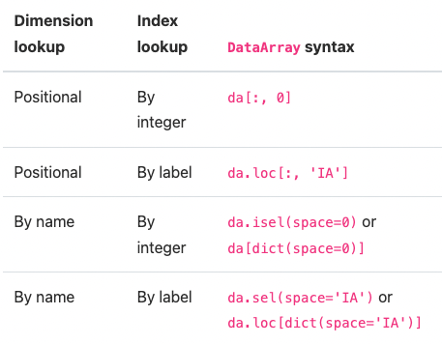
Xarray DataArray Selections
source: https://docs.xarray.dev/en/stable/user-guide/indexing.html

Slide 11
Xarray DataArray Interpolation
can interpolate along any or multiple dimensions
for example:
da.interp(time="2020-08-02")
source: Darren Wiens original (Sentinel-2)

Slide 12
SpatioTemporal Asset Catalog
“STAC”
Specifies a common structure for describing and cataloging spatiotemporal assets

Slide 13
Life Before STAC
Planet
Maxar
FTP Sites
Emails
Planet API
Maxar API
Manual Download
Manual Download
Download Code 1
Download Code 2
Download Code 3
Download Code 4
Use

Slide 14
Life With STAC
Planet
Maxar
FTP Sites
Emails
Database
STAC API
STAC API
STAC API
STAC API
Download Code
Use

Slide 15
Life With STAC
Planet
Maxar
FTP Sites
Emails
Database
STAC API
Download Code
Use

Slide 16
STAC API Example
Microsoft Planetary Computer
https://planetarycomputer.microsoft.com/
public STAC API containing many collections
Data Catalog: https://planetarycomputer.microsoft.com/catalog
STAC API: https://planetarycomputer.microsoft.com/docs/reference/stac/

Slide 17
STAC Specifications
4 specifications:
Catalogs
Collections
Items
API
Catalogs, Collections, and Items are JSON files* (or similar stored in a database)
JSON schemas (required properties, etc.) defined in the specs
https://github.com/radiantearth/stac-spec
https://github.com/radiantearth/stac-api-spec/
*JSON is like a Python dictionary

Slide 18
STAC Catalog
Container for other catalogs, collections, or items
Most commonly, there is a single catalog at the top level of a STAC catalog
Catalog
Microsoft Planetary Computer

Slide 19
STAC Collection
Container for other catalogs, collections, or items
Usually a collection contains many related items
Most commonly, there are many collections, one for each logical grouping of items
Microsoft Planetary Computer
Collections
Daymet
Sentinel-2
Level-2A
Landsat
Many others…

Slide 20
STAC Item
Documents describing a particular dataset that is associated with a date (or date range) and location
Contains links to geospatial assets and other metadata
Microsoft Planetary Computer
Daymet
Sentinel-2
Level-2A
Landsat
Many others…
Items
Daymet Items
Sentinel-2 Items
Landsat Items
Other Items

Slide 21
STAC Item Assets
Each STAC Item contains (among other things):
ID
geometry (geojson)
bbox
properties (must contains a datetime property)
links (URLs to itself, parent catalog/collection, etc.)
assets (actual data)
href (URL to the data)

Slide 22
STAC API
The STAC API spec defines how a STAC API should behave
STAC API
Microsoft Planetary Computer Catalog, Collections, and Items
Collection Info
Search Query
Other Endpoints
Matching Collections
Matching Items
Other Things

Slide 23
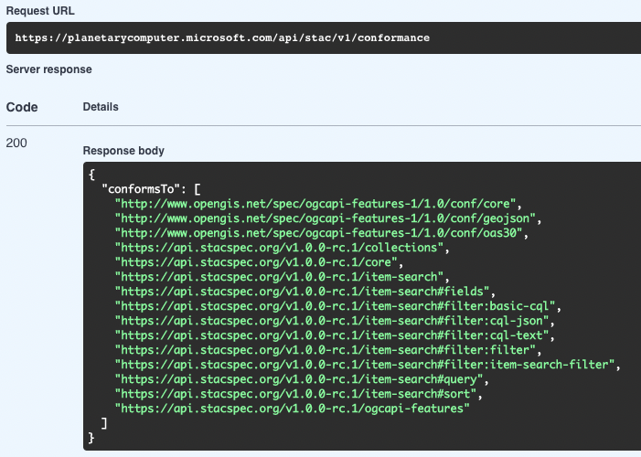
STAC API Conformance
There is a core API that defines very basic endpoints (e.g. list collections)
It also defines a conformance endpoint that lists the specs and extensions available in the API

Slide 24
STAC API Item Search
if the API conforms to the item-search spec, we can use the “/search” endpoint to search for matching items
item search is often implemented as both a GET and POST endpoint
when we send a GET request, the query parameters are embedded directly into the URL (e.g. “.../search?A=1&B=2&...”)
we can send complicated geojson geometries (many, many coordinates), so the URL can get extremely long, breaking many clients
POST requests allow us to embed data (like query parameters) alongside requests in JSON, circumventing URL length limits

Slide 25
STAC API Item Search
https://github.com/radiantearth/stac-api-spec/tree/main/item-search
example POST body:
{
"collections": ["landsat8","sentinel"],
"bbox": [10.415,36.066,3.779,44.213],
"limit": 200,
"datetime": "2017-05-05T00:00:00Z"
}
note that we can search across collections

Slide 26
STAC Assets
STAC Items do not contain spatial data, only links to data
The links can point to any file type
Good:
the links are to something we can download and load into numpy arrays, like a GeoTIFF
Even Better:
the links are to files that allow us to download only the pixels we want, like a Cloud-Optimized GeoTIFF

Slide 27
Cloud-Optimized GeoTIFFS (COGs)
COGs are a subset of traditional GeoTIFFs (they are both *.tif)
COG features:
the full resolution data is tiled
the file begins with a header describing the tiles
overviews (i.e. pyramids) are optional, but if included they must also be described with a similar header
Valid COGs support HTTP GET range requests, meaning that a COG reader can request and retrieve only certain bytes (i.e. pixels) within a given range (bounding box)

Slide 28
Xarray + STAC + COG = stackstac
https://stackstac.readthedocs.io/
converts STAC metadata into a lazy xarray DataArray
lazy = only loads data when necessary
creates an xarray shell with coordinates (e.g. lat, long, time, other attributes) that you can filter, mosaic, and aggregate upon
once ready, you can “compute()” the DataArray to fetch actual pixels from imagery assets (some functions implicitly call compute(), so you may not necessarily have to use the method)
if the assets are COGs and there is a bounding box filter, only those pixels will be fetched

